Slide 1

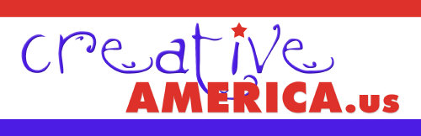
“The Politics of Creativity”
December 7, 2005
Tom Tresser

Slide 2

  WHAT’S SO
  GREAT ABOUT
  CREATIVITY?

Slide 3

Complete this statement:
“Creativity is critical because….”

Slide 4
Sound bite summary…
- Creativity as a national value
- Creativity is under threat
- Stop petitioning the government and start BEING the government
- We need YOU desperately!

Slide 5
Why mastery of creativity makes for winning politics…
U.S. creative heritage
Importance of creativity in U.S. economy
Number of creative workers
Champion creativity/Defend against threats
Leadership qualities of creatives

Slide 6
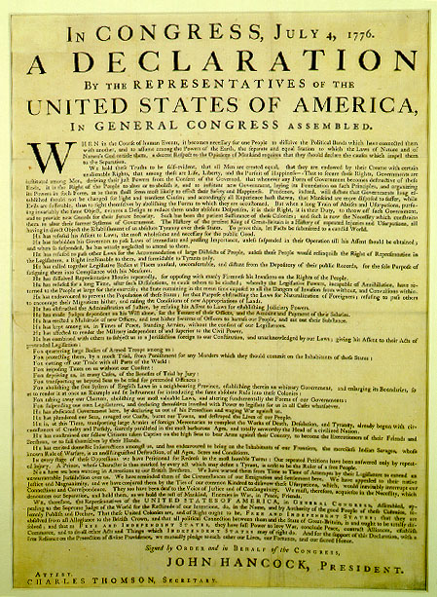
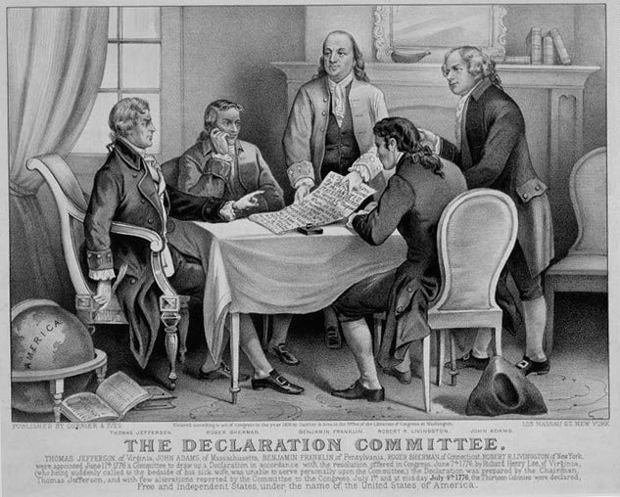
Creativity is our heritage

Slide 7
“We hold these truths to be self-evident, that all men are created equal, that they are endowed by their Creator with certain unalienable Rights, that among these are Life, Liberty and the pursuit of Happiness.
etc. etc.”

Slide 8
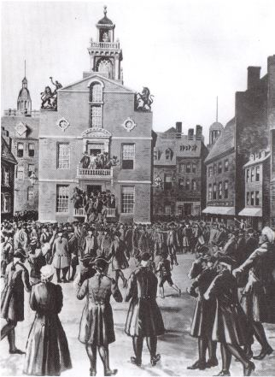
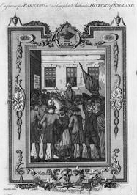
Tom Crafts reads the Declaration aloud in Boston - July 19, 1776

Slide 9
“The bells rang, the privateers fired the forts and batteries, the cannon were discharged, the platoons followed, and every face appeared joyful…After dinner the King’s Arms were taken down from the State House and every vestige of him from every place in which it appeared, and burnt…Thus ends royal Authority in this State…and all the people shall say Amen.”
Abigail Adams letter to John describing Tom Crafts, a house painter, reading of the Declaration of Independence aloud on July 19, 1776 from small balcony in front of the Massachusetts State House, Boston.

Slide 10
U.S.A!
U.S.A!
U.S.A!
U.S.A!

Slide 11
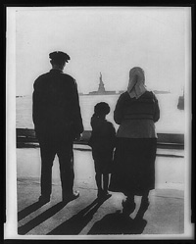
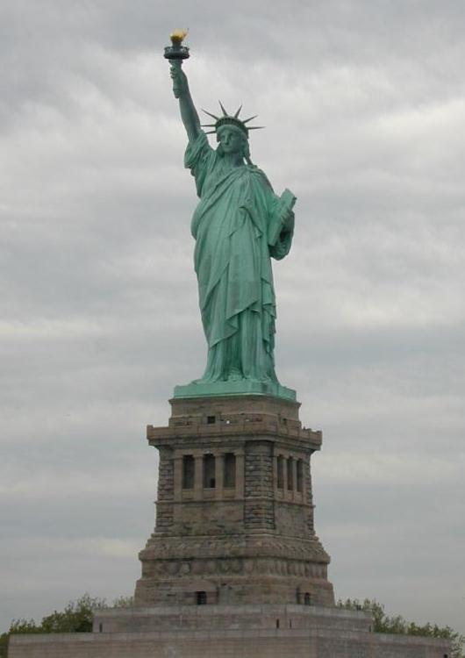
Creativity is our promise
35,000,000 people in U.S. born abroad

Slide 12
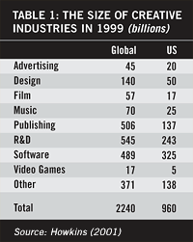
Creativity drives our economy
U.S. creative industries 1999 est = $960 billion!
John Howkins, “The Creative Economy”

Slide 13
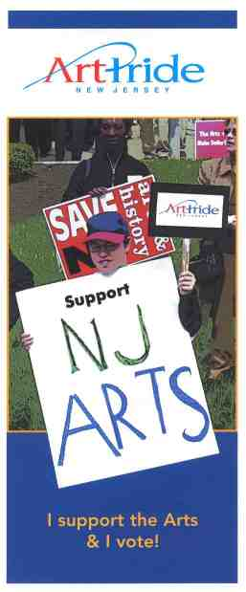
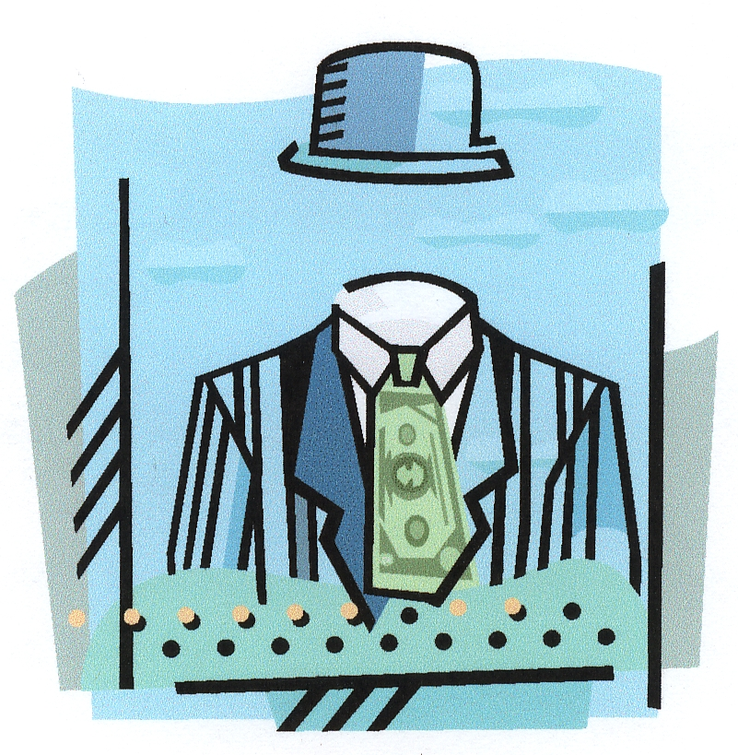
Creativity and the economy
NJ arts industries 2000 estimated total economic impact = $1.02 billion!

Slide 14
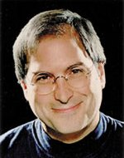
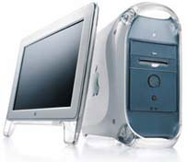

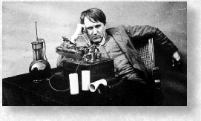
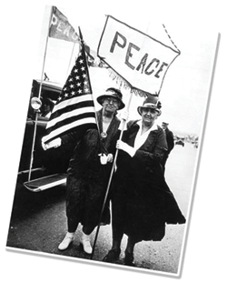
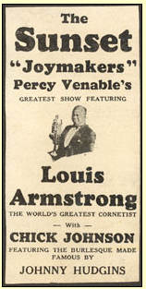
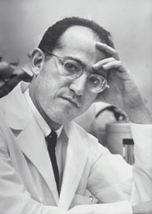
Creativity Drives U.S. Social + Economic Progress
Jane Addams
Jonas Salk

Slide 15
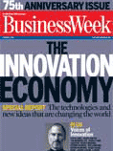
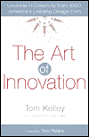
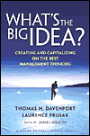

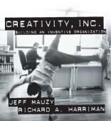
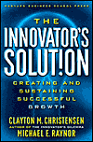
Creativity in business

Slide 16

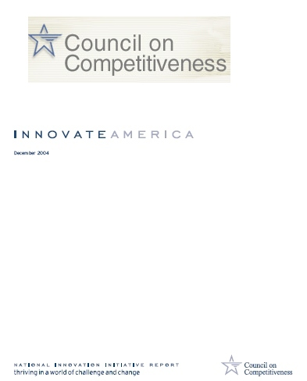
“Innovate America” – National Innovation Initiative Report, December 2004

Slide 17
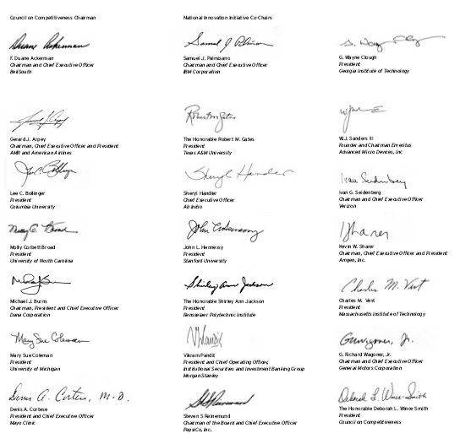
REPORT SIGNED BY CEOS OF 11 MAJOR US COMPANIES AND PRESIDENTS OF 8 UNIVERSITIES!
BellSouth, IBM, American Airlines, Advanced Micro Devices, Ab Initio, Verizon, Amgen, Dana, Morgan Stanley, GM, PepsiCo
Georgia Institute of Technology, Texas A&M, Columbia University, University of North Carolina, Stanford, Rensselaer, MIT, University of Michigan

Slide 18
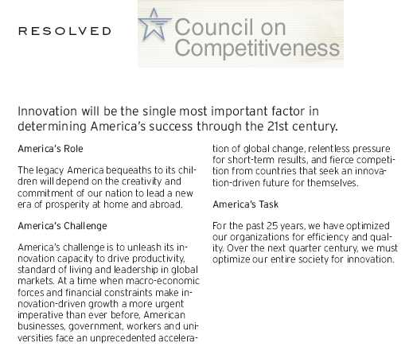
PAGE 1:
“RESOLVED --
Innovation will be the single most important factor in
determining America’s success through the 21st century.”

Slide 19
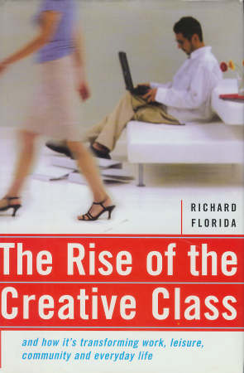
Number of creative workers

Slide 20
Economic progress directly related to management, nourishment and celebration of region’s creative assets.

Slide 21
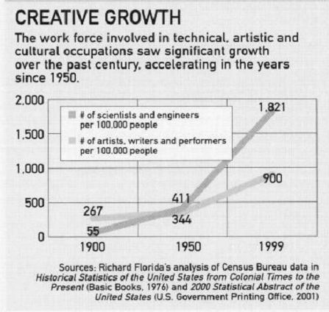

Slide 22
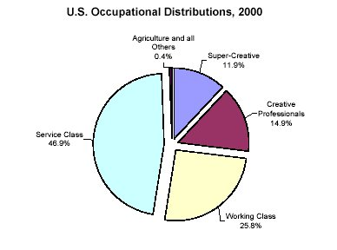
Rise of Creative Class
Creative class =
* Super-Creatives,
15 million workers +
* Creativity pros,
23 million workers
38 million strong 28% U.S. work force
“The Rise of the Creative Class,” Richard Florida

Slide 23
Super-Creative Core:
Computer and mathematical occupations
Architecture and engineering occupations
Life, physical, and social science occupations
Education, training, and library occupations
Arts, design, entertainment, sports, and media occupations
Creative Professionals:
Managerial occupations
Business and financial operations occupations
Legal operations
Healthcare practitioners and technical operations
High-end sales and sales management

Slide 24
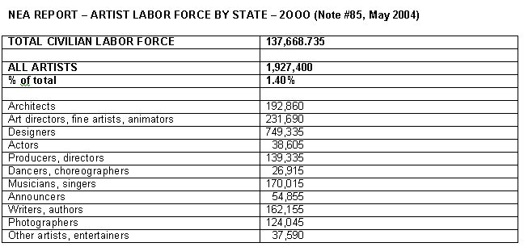
1,927,400 US Artists –
How many not counted?

Slide 25
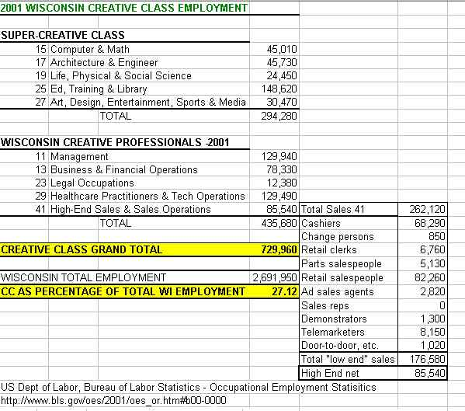
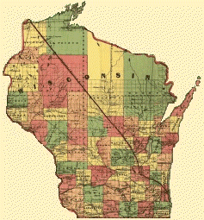
27%

Slide 26
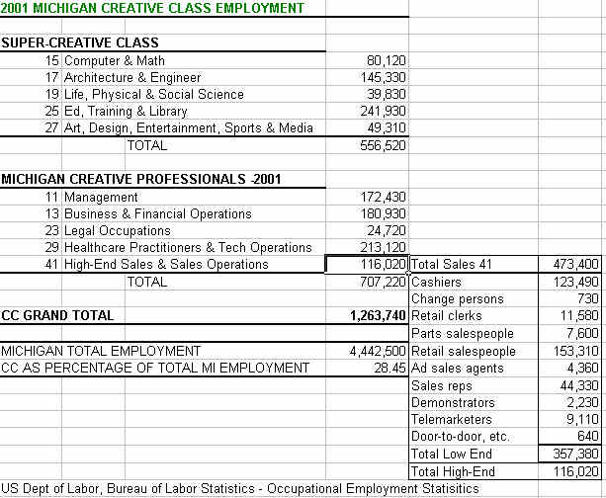
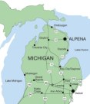
28%

Slide 27
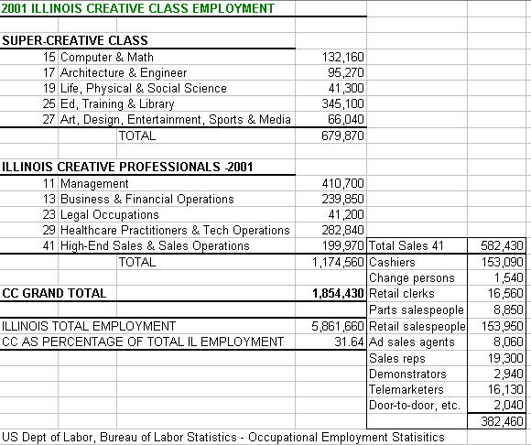

32%

Slide 28
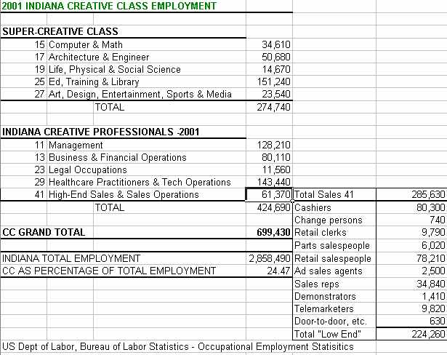
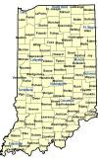
24%

Slide 29
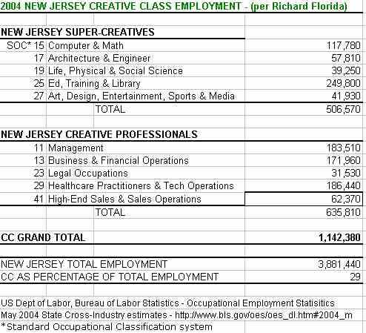
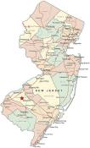
29%

Slide 30
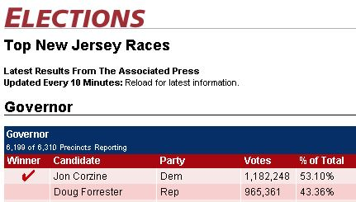
NJ Creative Class
“Super-Creatives” = 506,570
“Creative Professionals” = 635,810
TOTAL = 1,142,380
Margin of victory =
216,887

Slide 31
NJ Creative Class
“Super-Creatives” = 506,570
“Creative Professionals” = 635,810
TOTAL = 1,142,380
2005 PRIMARY FOR GOVERNOR
Jon Corzine (D) = 207,670
Doug Forrester (R) = 108,941
Bret Schundler (R) = 98,417
Margin of victory = 14,524

Slide 32
Champion creativity/
Defend against threats

Slide 33
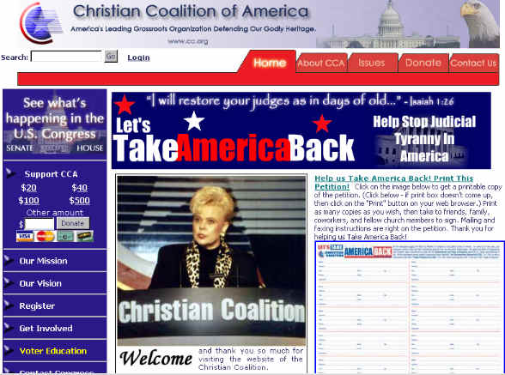

Slide 34
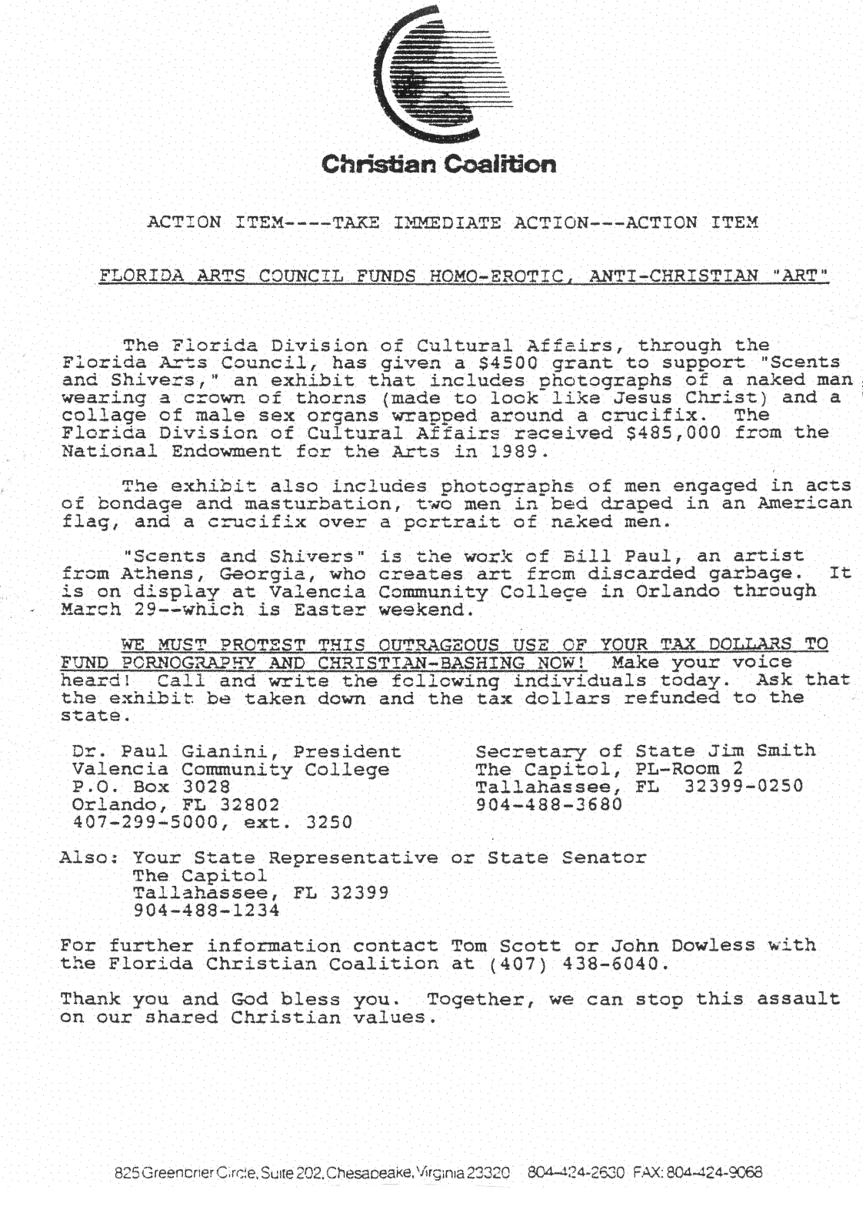
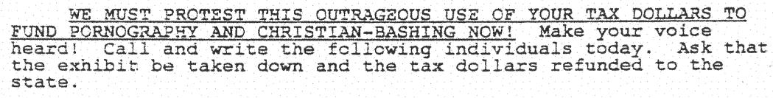
1992
First of three mailings protesting “Scents and Shivers” at Valencia Community College, Florida.

Slide 35
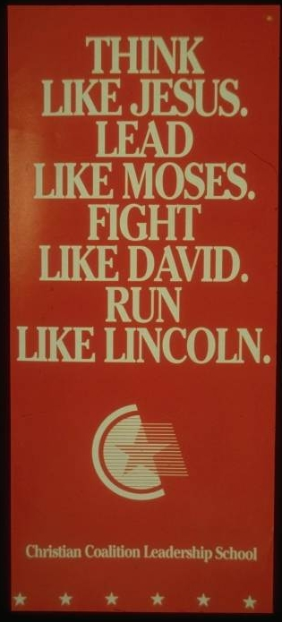
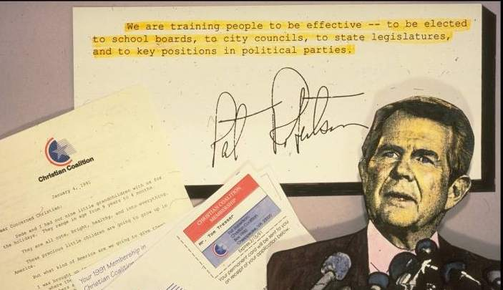
1992

Slide 36
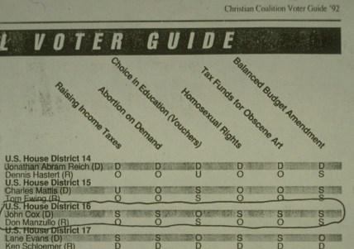
1992
The Christian Coalition distributed 19 million voter guides in 1996.

Slide 37
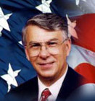
2003 Americans for the Arts = 0%
2003 Sierra Club = 0%
1999 Consumer Federation of America = 25%
2003 Business-Industry PAC = 100%
2001 People for the American Way = 6%
1999 American Bar Association = 0%
2003 AFL-CI0 = 13%
2003 Brady Campaign to Prevent Gun Violence = 0%
2002 Coalition to Stop Violence = 0%
2001 Children’s Defense Fund = 18%
Rep. Don Manzullo, IL-16
Source: www.vote-smart.org

Slide 38
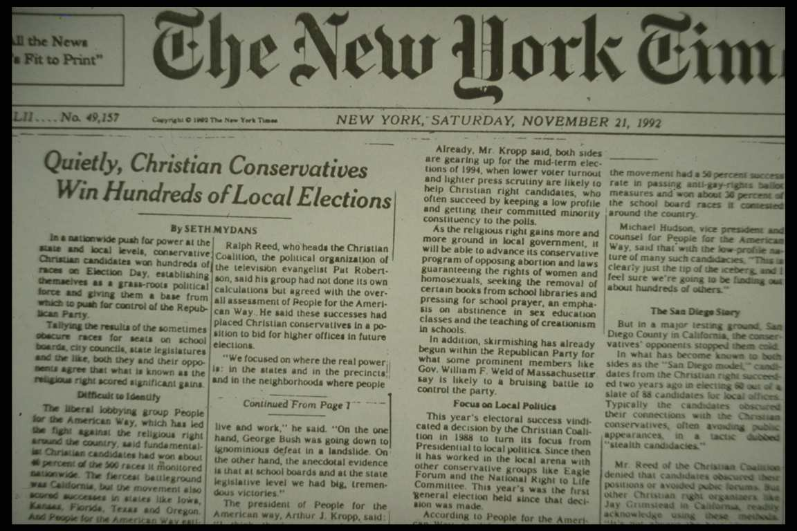
1992

Slide 39
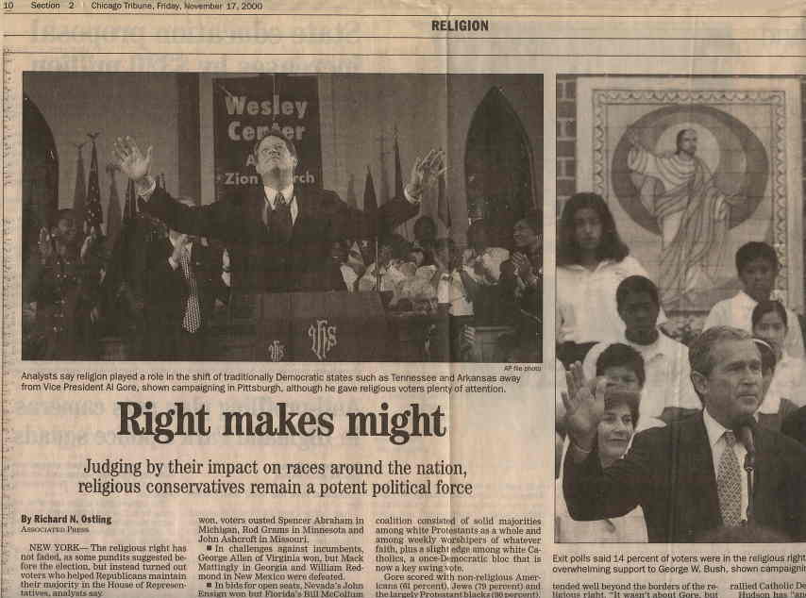
2000

Slide 40
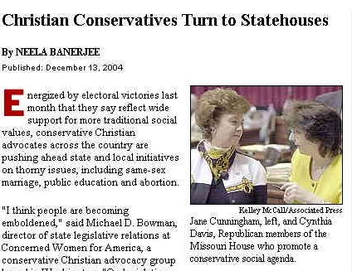
2004

Slide 41
The Christian Coalition
(and their allies)
have successfully –
Identified their base
Energized their base
Expanded their base
Trained their base
Activated their base for $ and leadership
Translated this organizing into electoral victory and public policy

Slide 42

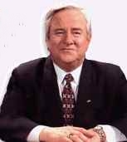
On the 9/11 attacks –
"I really believe that the pagans, and the abortionists, and the feminists, and the gays and the lesbians who are actively trying to make that an alternative lifestyle, the ACLU, People For the American Way, all of them who have tried to secularize America. I point the finger in their face and say 'you helped this happen’ [by] throwing God out of the public square, out of the schools. The abortionists have got to bear some burden for this because God will not be mocked."
- The 700 Club TV show 9-14-01
Rev. Jerry Falwell

Slide 43
GOAL = 1 million members @ $25 each –
asking for non-tax deductible contributions!
The Moral Majority Coalition Platform:
Platform # 1
The Moral Majority Coalition will conduct an intensive four-year "Voter Registration Campaign" through America's conservative churches, para-church ministries, pro-life and pro-family organizations.
Platform #2
The Moral Majority Coalition will conduct well organized "Get-Out-The-Vote Campaigns" in 2006 and 2008.
Platform #3
The Moral Majority Coalition will engage in the massive recruitment and mobilization of social conservatives through television, radio, direct mail (U.S.P.S. and Internet) and public rallies.

Slide 44
Meanwhile creativity in the US is
under assault on a number of fronts…
Erosion of church-state barrier
Decline U.S. literacy rates
30% U.S. high school drop-out rate
Religious screening of scientific research
Difficulty of minority/women access to science/engineering advanced degrees
Threats to freedom of expression
Rise of intolerance, hate-based politics
Declining support for the arts/Access to arts and culture resources depending on income

Slide 45
We need
a little diversity…

Slide 46
2004 – 7,382 total State Legislators….
Male = 77.5%
Female = 22.5%
Average age = 54
White = 77%
Attorneys, business related background = 80%
Education related background = 7%
Communication arts/broadcasters = 1.5%
Artists/Creative professionals = 0%

Slide 47
Leadership qualities of creatives
Guess what?
You’re already a leader!

Slide 48
LEADERSHIP ASSET INVENTORY

Slide 49
Artists + creative professionals can offer their:
  creative skills & resourcefulness
  tolerance & ability to be empathetic
  ability to build ensembles
  ability to challenge old assumptions
  passion, compassion and optimism
  pursuit of truth & authenticity

Slide 50
lead a neighborhood organization
lead inside a chamber of commerce
lead inside your church’s social action committee
organizer voter registration drives at cultural spaces
organize “Arts for Jones” committees/events
organize candidate forums and accountability sessions
Always as a
Creativity Champion!

Slide 51
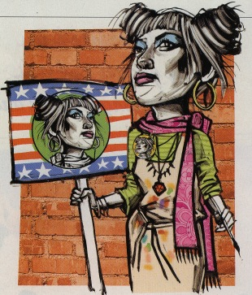
Run, Baby, Run!
LOCAL OFFICE:
School board
Library board
City Council

Slide 52



Examples of artist/creative elected officials…
Kathie deNobriga, Founder of Alternate ROOTS- member of Lake Bluff City Council, GA.
Ras Baraka, Poet, Educator, Activist - Deputy Mayor, Newark, NJ
Stanley Rosenberg, founder Arts Extension Service - State Senator, MA.

Slide 53
CREATIVITY AS THE BASIS FOR A WINNING POLITICS IF WE…
Connect creativity to American heritage/promise
Show the value – economic and social capital
Activate our base – organize, train, support
Stand up for creativity – articulate a positive agenda
Believe in ourselves – tell your stories, ask for the “sale”

Slide 54


Slide 55
Tom Tresser
Lead Organizer
312-804-3230
tom@creativeamerica.us
www.creativeamerica.us
“People Have the Power” – Patti Smith

Slide 56

Message:
America is a “work-in-progress” and we’re all artisans -- citizen-makers of our commonwealth -- lending our vision and talent to making America a masterpiece!

Slide 57
Message:
A prosperous and fair America needs all her citizens ready and able to create and contribute to their maximum.

Slide 58
What are the implications for education policy?
…for human rights policy?
…for urban development policy?
…for national security policy?

